Slide 1
GPT-3
Generative Pre-training Transformer 3

Slide 2
References
https://arxiv.org/pdf/2005.14165.pdf

Slide 3
What is GPT
GPT uses a generative model of language (where two neural networks perfect each other by competition) and is able to acquire knowledge of the world and process long-range dependencies by pre-training on diverse sets of written material with long stretches of contiguous text.

Slide 4
GPT Evolution
GPT1 – 110 million parameters
GPT2 - 1.5 billion parameters
GPT3 utilizes 175 billion parameters

Slide 5
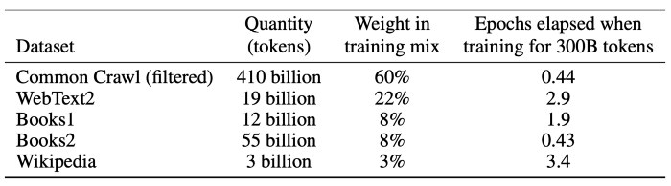
Training Set
CommonCrawl builds and maintains an open repository of web crawl data that can be accessed and analyzed by anyone. The Common Crawl corpus contains petabytes of data collected since 2008.
The English Wikipedia, spans 6 million articles.

Slide 6
GPT Domains
GPT-3 achieves strong performance on many NLP datasets.
Translation
Q&A
Filling in missing text
Tasks that require on-the-fly reasoning or domain adaptation
Unscrambling words
Using a novel word in a sentence
Performing 3-digit arithmetic.

Slide 7
How to Use GPT
Given any text prompt, the GPT-3 will return a text completion, attempting to match the pattern you gave it.
You can “program” it by showing it just a few examples of what you’d like it to do, and it will deliver a complete article or story.

Slide 8
How Good?
GPT-3 can generate samples of news articles which human evaluators have difficulty distinguishing from articles written by humans.

Slide 9
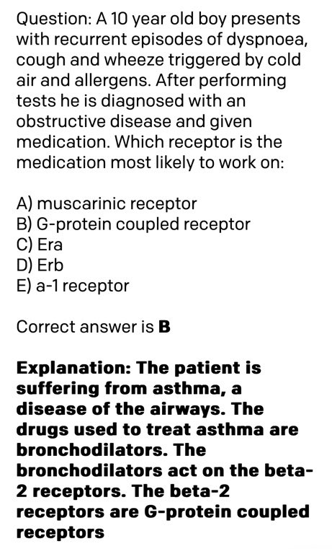
Medical Question

Slide 10
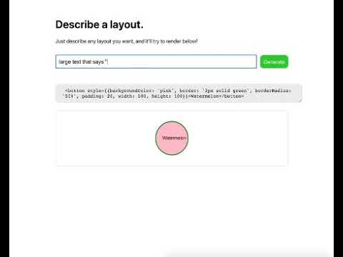
Coding
https://www.youtube.com/watch?v=frDG-dKOnsw

Slide 11
Keras Model Generation
https://twitter.com/mattshumer_/status/1287125015528341506

Slide 12
Generate Email Response
https://twitter.com/OthersideAI/status/1285776335638614017

